Slide 1
to
Easy of Access to Learnig
Education
VNR Community Question Bank
https://vnr-qb.w3spaces.com/
ME -04

Slide 2

Team Members
P. Saran chinmai 19071A0236
Md.Khaleel shareef 19071A0395
Sai Kiran 19071A0436
Uday N 20075A0205
Koushik 20075A0310

Slide 3
CATALOGUE
01
Methodology
02
Problem Statement
Problem Statements Defining
Methodology of Research , Survey link , Responses .
Insights
03
Web UI
04
Differnent Kinds of Needs .
Soution Protoype , Interface , Resources.

Slide 4
PART ONE
Problem Statement
A problem statement is a concise description of the problem or issues a project seeks to address. The problem statement identifies the current state, the desired future state and any gaps between the two.

Slide 5


Problem Statement
Students are struggling to find previous question papers for reference. All the question papers are scattered and most of them are totally absent.
An easy way to navigate through all the question paers and making students easy to search through all the papers without hassle.
The library of question papers should not be confined to one year or semester. All the year question paper must be easy to access.

Slide 6
PART TWO
Methodology of Research
Research methodology simply refers to the practical “how” of any given piece of research. More specifically, it’s about how a researcher systematically designs a study to ensure valid and reliable results that address the research aims and objectives.

Slide 7

Methodology of Research
A survey has been conducted among students to know the problems they are facing in procuring QP’s.
After analyzing the survey record,many students feel that a platform where students and faculty would interact will be a better option to get good guidance and support from them in various phases of their college life.
Survey link
https://forms.gle/d2S27wPp1CFHknqcA

Slide 8
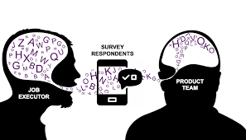
Questions Asked in the Survey form
Section 1
Name
Category
Do you feel Prev.Quesion papers are useful and you can benift from them ?
Do you frequently refer Previous Year Question Papers ?
01
Section 2
Do you feel any difficulty in finding Prev.Question Papers ?
What is/are your Soucre of finding this Material ?
What do feel about the Quality of Material you get ?(Rating : 1 to 5 )
Will it be comfortable to find all the papers at one place ?
Feel Free to Share Your Experience regarding Previous Question Papers
Demonstrate

Slide 9
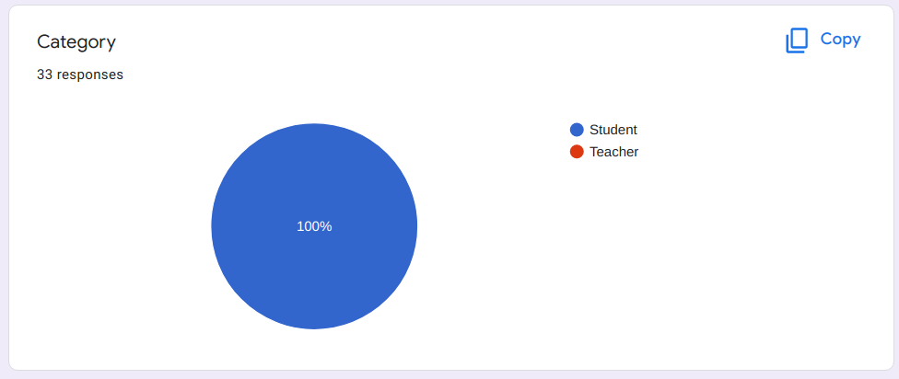
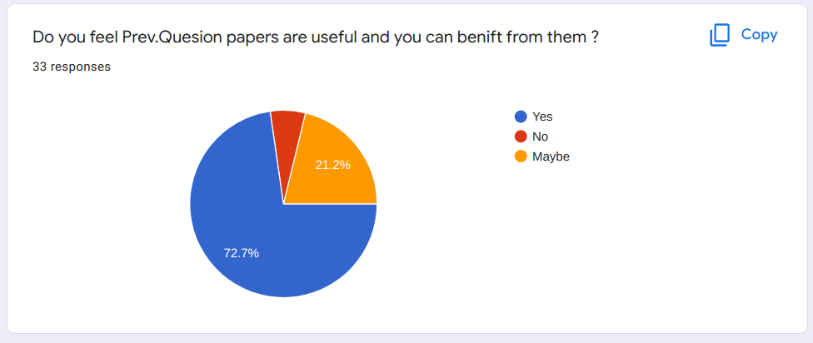
Responses from the survey
01
01
02

Slide 10
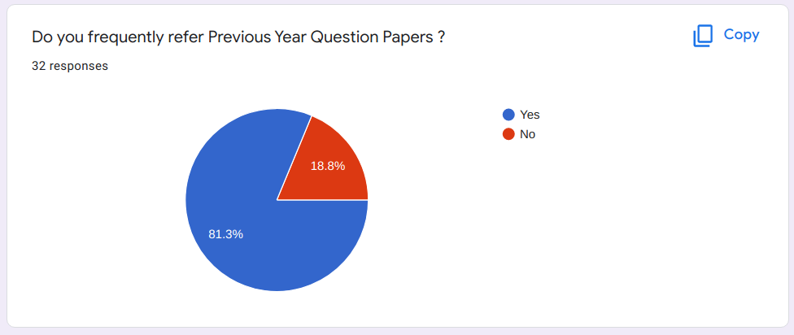

Responses from the survey
03
01
04

Slide 11
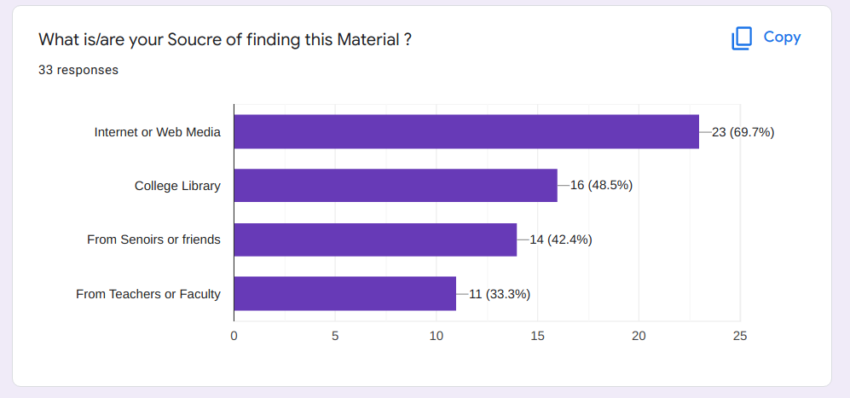
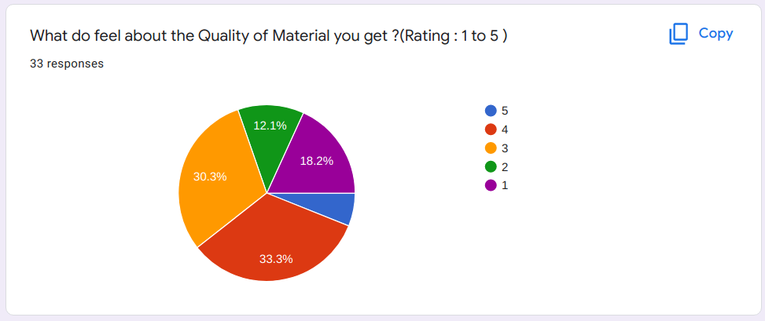
Responses from the survey
05
01
06

Slide 12
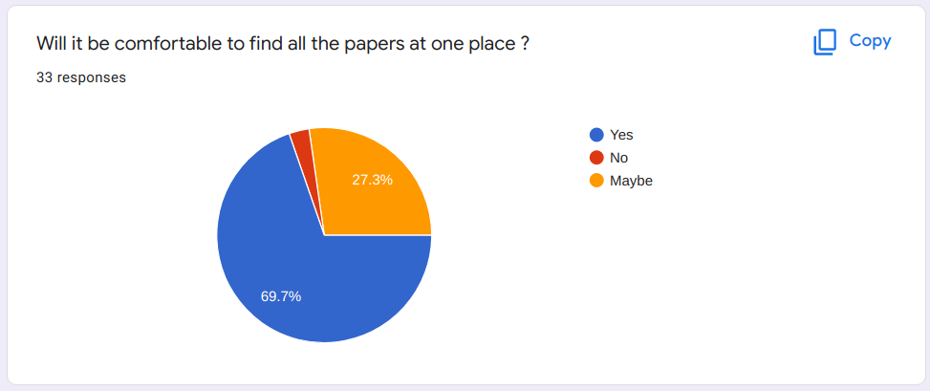
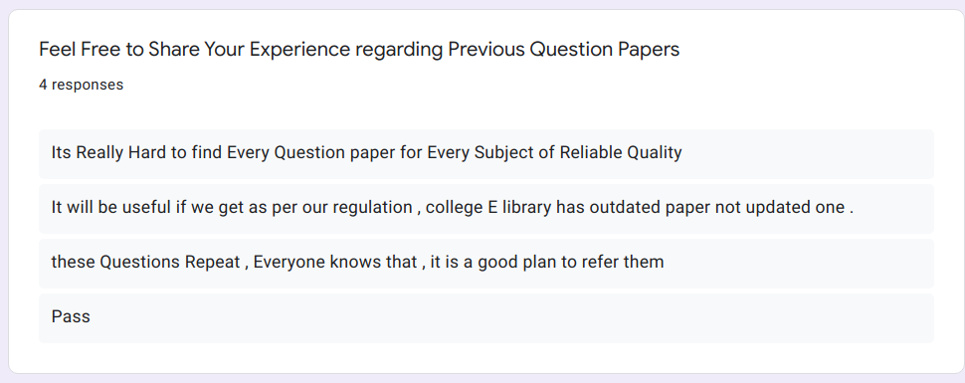
Responses from the survey
07
01
08

Slide 13
Persona
Students and Tutors are the users who are benefited from the proposed solution.
Students
Students are the users who are benifited from the website
It helps to understand the important parts of the syllabus.
It Increases the confidence of the candidates
It help to manage the time.
It Helps to chalk out the similar questions.
It helps the student to plan his examination.
Tutors
Tutors can create a post to share any material
which can reach to students of all branches.
Helps with Version control and sampling
Makes Planning Easier

Slide 14
PART THREE
Insights
A problem statement is a concise description of the problem or issues a project seeks to address. The problem statement identifies the current state, the desired future state and any gaps between the two.

Slide 15

Tutors can share knowledge over various platforms other than classroom
Easy for students to collect and use material .
Students can easily get all materupdates material needed at one place
Primary Needs
Any need of the customers which is short term and is easily available is known as primary need.
Secondary Needs
Latent Needs

Slide 16
Students get to engage in the community work.
Can show ways, share ideas and make students more active.
Primary needs
Secondary Needs
Latent Needs

Slide 17
Students need not waste their time in searching for the Reliable Material.
When all the shared information by Tutor is grouped at one place can make it as a help which a faculty can use further.
Primary needs
Seondary needs
Demonstrate
Latent Needs
Latent needs can be defined as a desire or preference which cannot be satisfied due to a lack of information or availability of a product or service. Or, in plain English, a latent need is a problem that a user or consumer doesn't realise they have.

Slide 18
PART FOUR
DEMONSTRATE

Slide 19
SERVICE EXPERINCE CYCLE
PAIN POINTS TO THE USER GROUP
Many students are struggling
to find all the Materials
They are confused due to
Many Versions (regulation)
Feeling discomfort : need to collect from material from differnet soucres
Time Waste and was not getting
Quality Material

Slide 20
SERVICE EXPERINCE CYCLE
GAIN EXPECTED OUT OF THE SOLUTION:
Leaners Can Acess Useful Material Easily .
Saves Time as all the Reqired Content is at the same place
Version can be managed with ease as lot of support is available through users

Slide 21
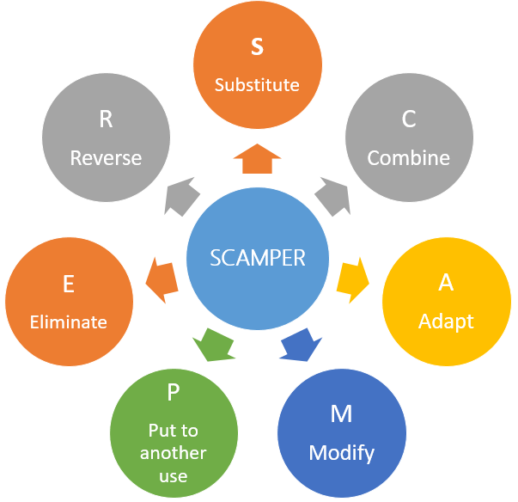
IDEATION METHOD-SCAMPER
SUBSTITUTE:
In traditional ways, when students need a necessary material , they try to approach their friends, known faculty.
They invest some time in finding the right material for help and it takes some time in finding.
So, when both students and tutors are bought under one platform we can eliminate all the difficulties which students are facing.
COMBINE:
Generally, knowledge shared by the faculties is limited to a class or group of students. Knowledge is to be shared without boundaries.
Students are in path of building their career.
When these two users are both under one roof creates benefits at great extent.

Slide 22
IDEATION
ADAPT
We would like to get a way where students are getting proper material in all cases and build an environment to develop a sense of ease.
MODIFY
We are trying to change the way of providing useful and necessary data to both tutors and students .
PUT TO OTHER USE
In mean time, It helps in developing a college community like culture.
ELIMINATE
We would like to eliminate the problems in knowledge sharing process.
REVERSE
Knowledge sharing has no limits. Knowledge sharing can be like two-way handshaking. So, students can also share knowledge and contribute to the community.

Slide 23
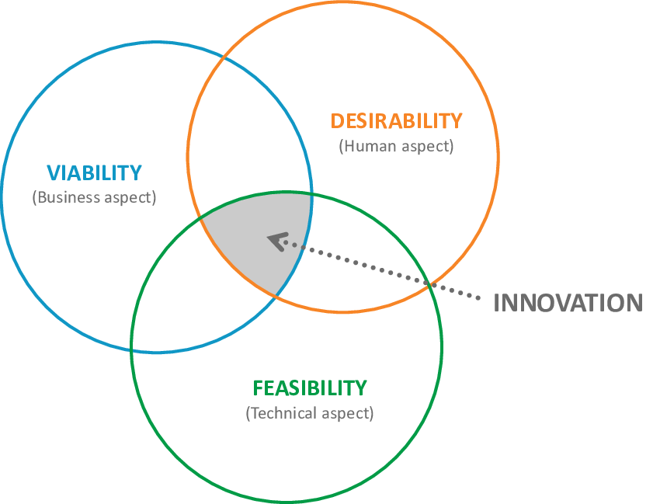
FINAL REAL-WIN-WORTH
Our Website is user friendly.
Our Website is Responsive (i.e. Compatabile with Mobile and Desltop
Students can get interest in accessing website to get connected.
It is desirable as it servers the purpose without making things complex.

Slide 24
FINAL REAL-WIN-WORTH
VIABILITY AND FEASEBILITY:
This Web app is built using front end technologies like HTML Bootstrap, JQuery , CSS .
Google Drive makes it more easy and No-Cost
Website light and creates a best user interface with magnificent UI.
Technically it is feasible and simple to implement.
This solution is economically feasible as well.
Time taken to build the web app is considerate and not long.

Slide 25
PART FIVE
Web UI

Slide 26
Downloads
Contains sub section to navigate
Web Interface
Contact
For Suggestions and Requests
About
Provides basic information

Slide 27
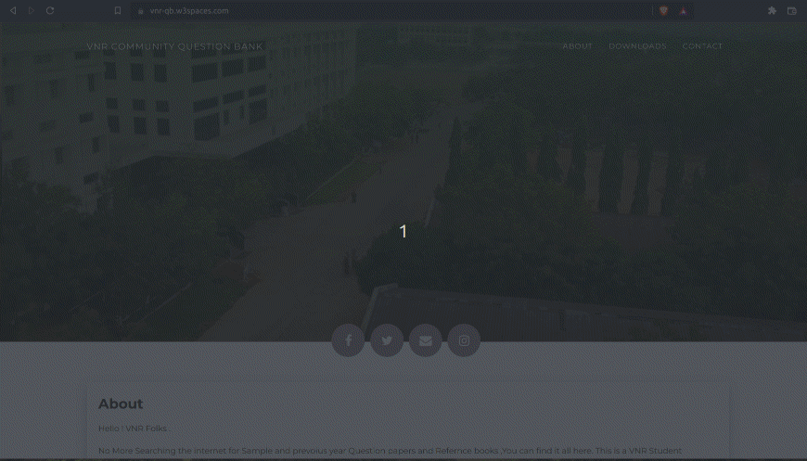
Solution Prototype

Slide 28
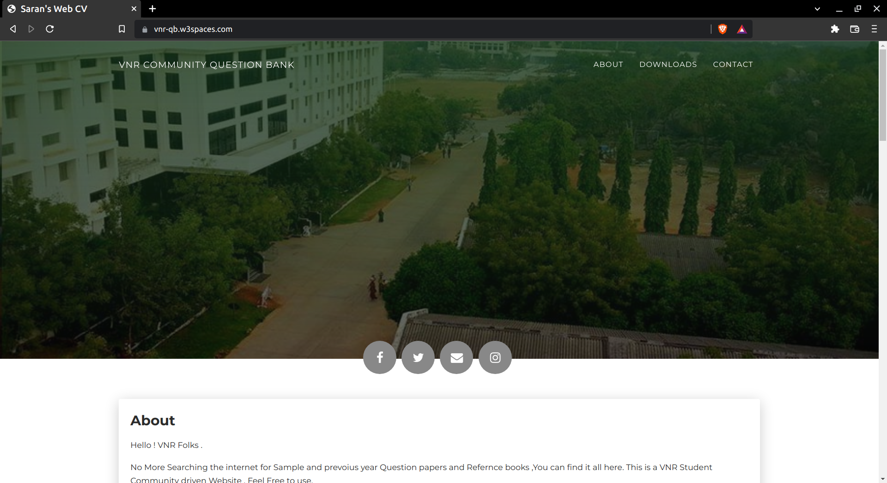
Solution Prototype
Home Page

Slide 29
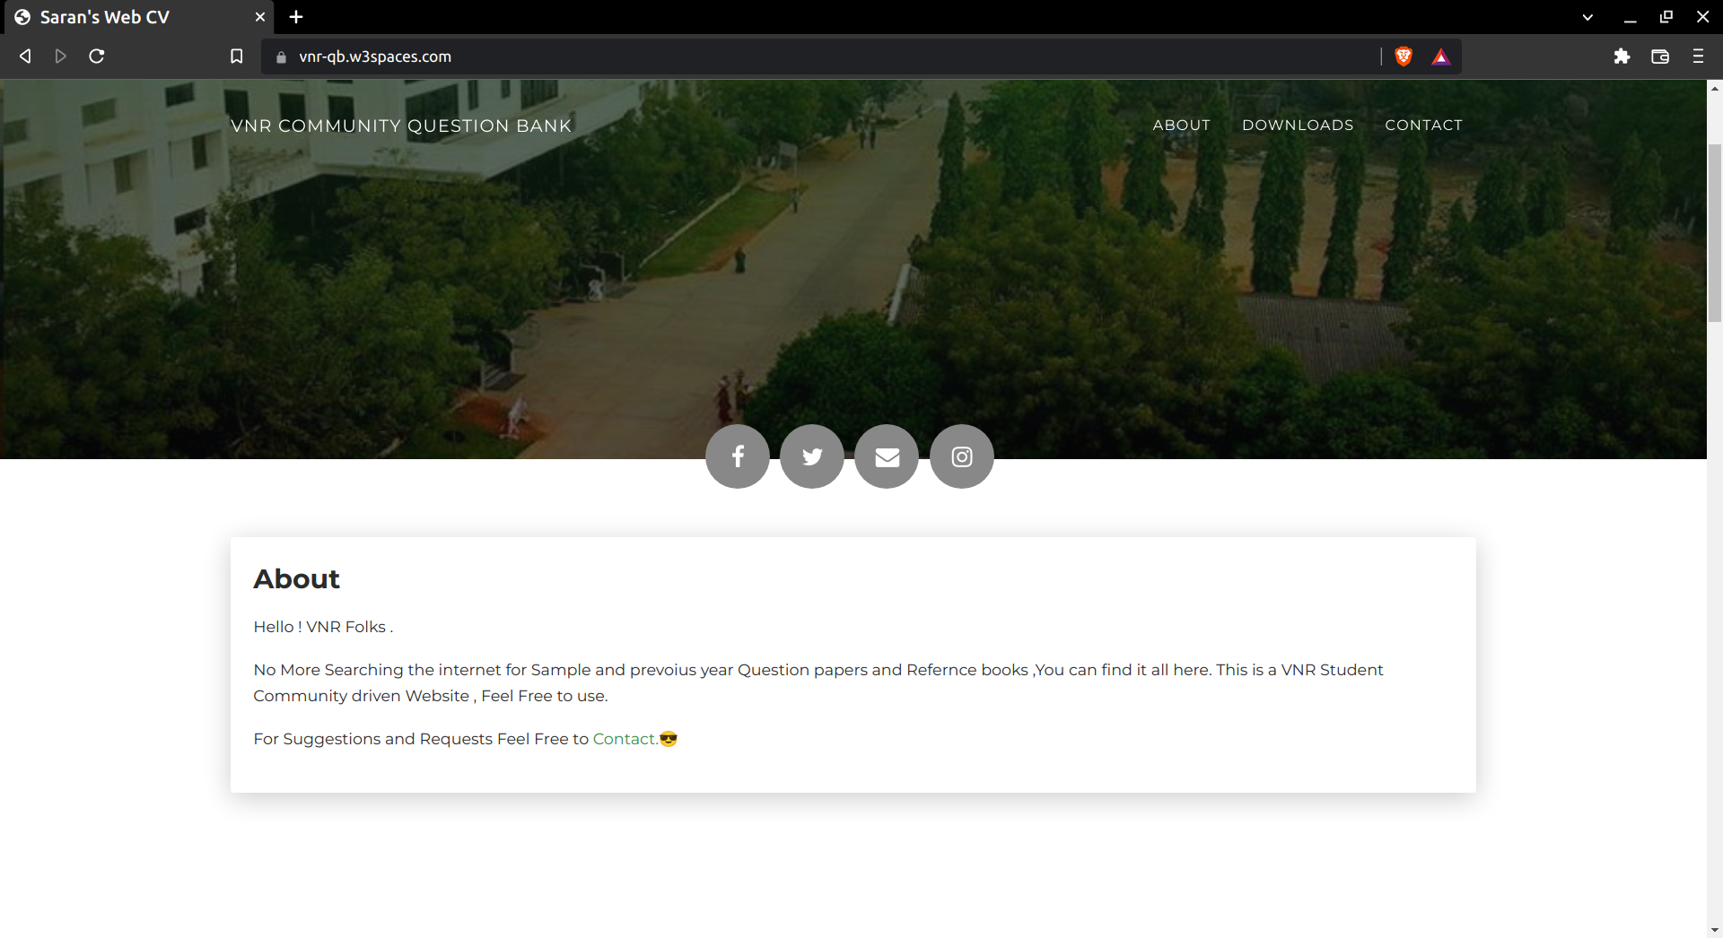
Solution Prototype
About Section

Slide 30
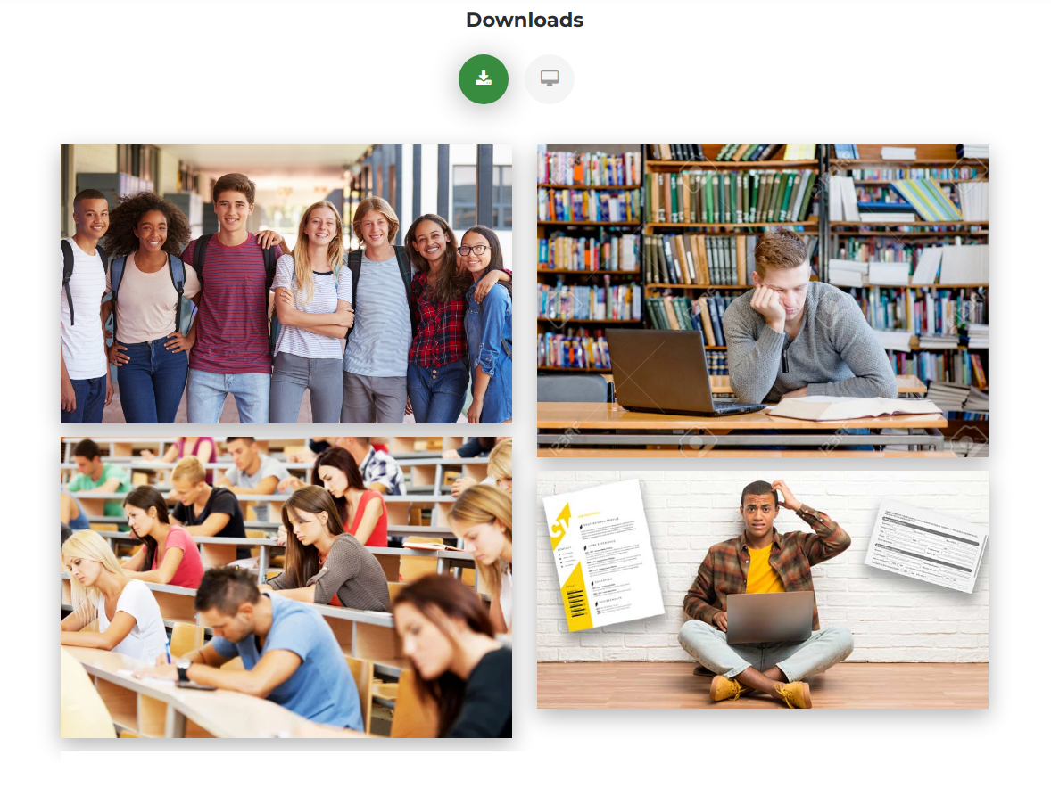
Solution Prototype
Downloads Section

Slide 31
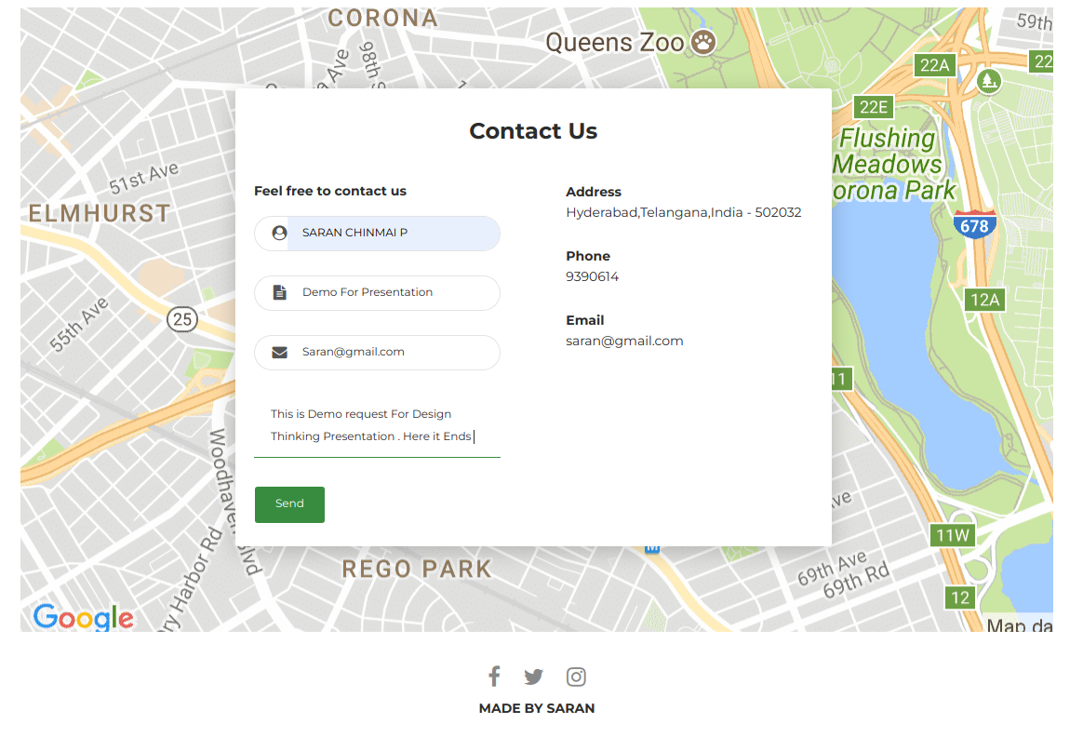
Solution Prototype
Contact Section

Slide 32
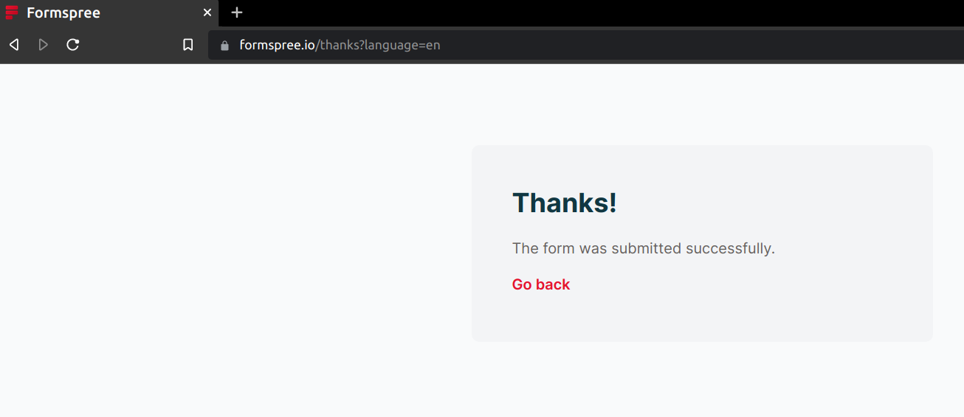
Solution Prototype
Request Sucess Page

Slide 33
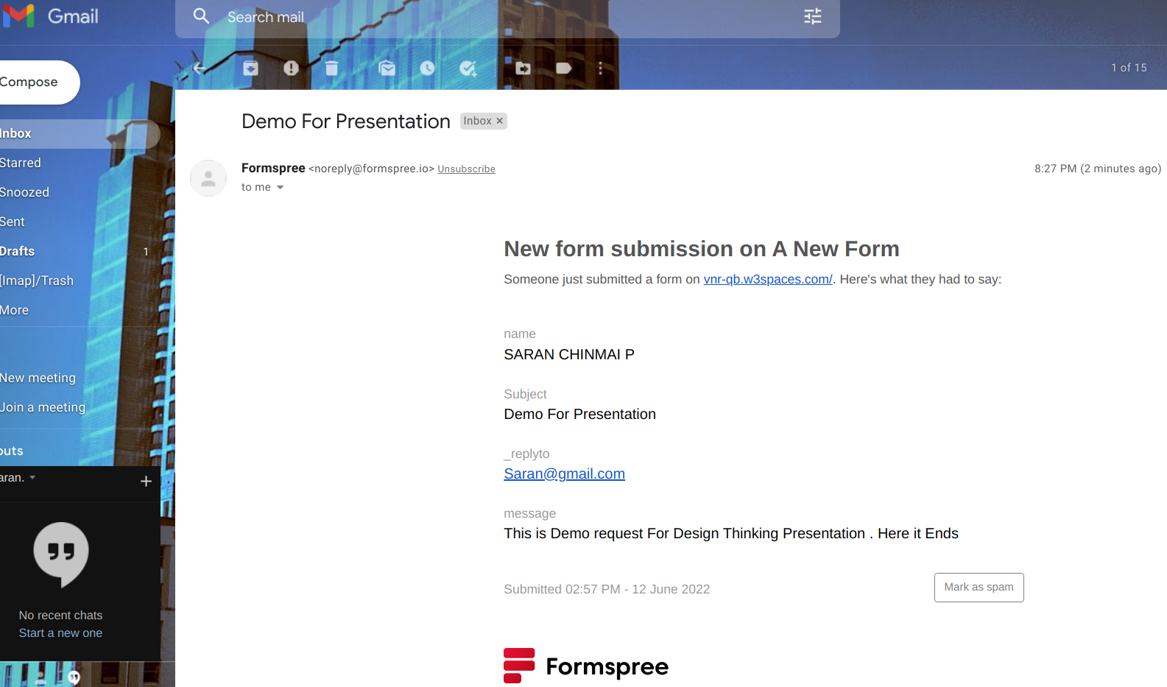
Solution Prototype
Request recieved to Mail

Slide 34
Design for Environment
Our solution is sustainable, it is easy to maintain in the long run.
It being a software will not wear out with time.
Any bugs identified in the process can be rectified and the software can be deployed again.

Slide 35
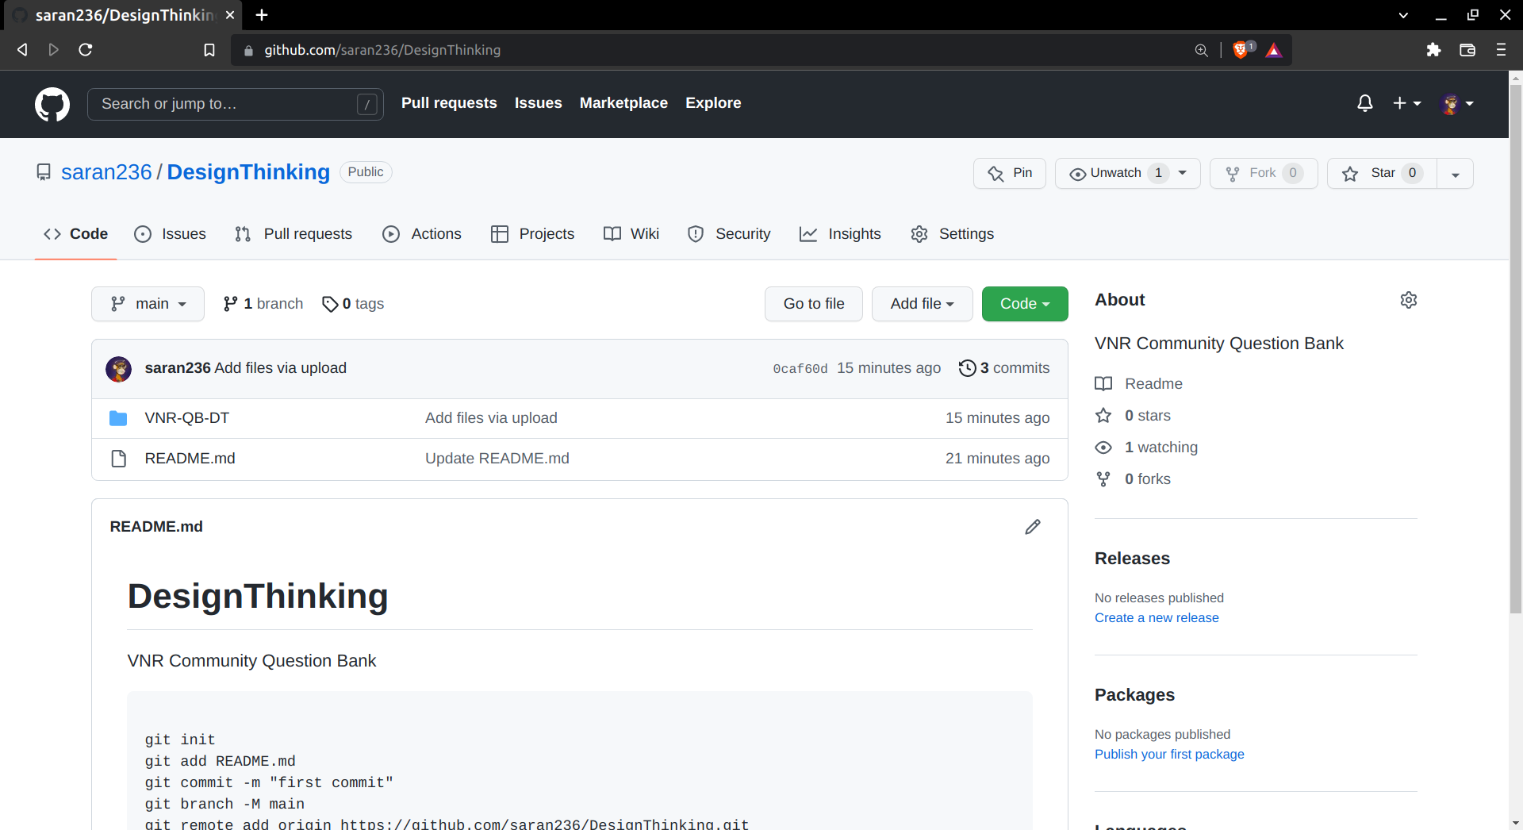
Resources
You can find the Source Code and the Complete Project in my GIT Repository
github.com/saran236/DesignThinking

Slide 36
End
THANK YOU
P . Saran chinmai

